Slide 1
Latent variable models
Session 1 – Introduction

Slide 2
Course prerequisites
Knowledge of statistics
Statistical testing (e.g., chi-square & normal distributions)
Regression (GLMs)
Var, cov, cor, mean
Knowledge of psychometrics
Validity
PCA, EFA, CFA
Reliability
IRT
Programming in R

Slide 3
Course materials
Book(s):
Beaujean, A. A. (2014). Latent variable modeling using R: A step-by-step guide.
Good as a starting guide, not an authorative standard
Kaplan, D. (2009). Structural Equation Modeling: Foundations and Extensions.
Authorative standard. But more technical and not focused on specific software, not practical for current course.
GitHub repo:
Lecture slides
Markdown files with examples, exercises and answers

Slide 4
Book examples
You are strongly advised to copy and run R code from examples in Beaujean book and from GitHub repo:
They give you a step-by-step guide on how to perform analyses
They give you a starter for making the exercises
If you make a mistake, you will get an error or warning message, from which you can learn alot! (But only if you try to decipher it, red = good!)

Slide 5
Structural Equation Modeling
Structural: We aim to explain associations between (that is, the structure of) observed variables
Equations: Associations between variables are described using mathematical formulae
Modeling: we construct models (hypotheses, theories) of reality. The models can be statistically tested. That is: rejected by the data (or not), but never proven ‘true’ or ‘right’.
All models are wrong, but some are useful.

Slide 6
Structural Equation Modeling
SEMS are graphically represented using these building blocks:
Observed (manifest) variable
Directional relationship (regression relationship)
Non-directional relationship
(correlation/(co)variance)
Latent variable
Constant term (i.e., not a variable, e.g., intercept)

Slide 7
Structural Equation Modeling
Arrows in SEM denote regression relationships
All generalized linear models (GLMs) can be formulated as a SEM:
t-test
ANOVA
Multiple linear regression
Multiple logistic regression
…..
Also, SEM can be used to models for multilevel or longitudinal data (i.e., GLMMs)

Slide 8
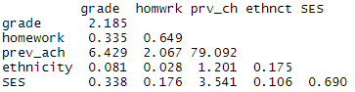
Example dataset
Variables in the model:
GPA in 10th grade
Ethnicity
Homework (8th grade)
Socio-economic status
Previous achievement (8th grade)
Sample covariance matrix S:
grade
ethnicity
homework
SES
Prev_ach

Slide 9
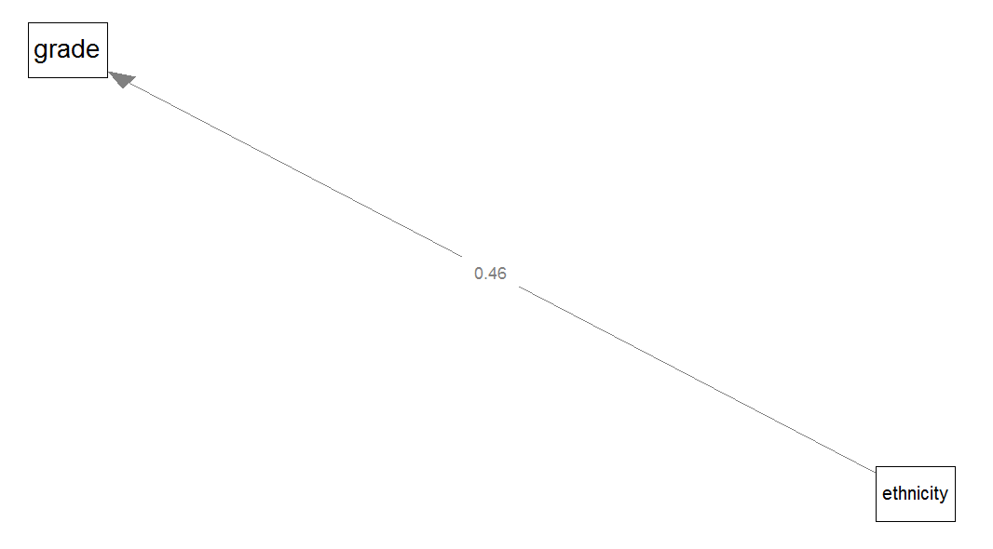

Model: Univariate regression
Dependent:
GPA in 10th grade
Independent:
ethnicity (0=ethnic minority; 1=ethnic majority)
Regression coefficient easy to calculate by hand:
${\hat{b}}_{xy}=$ $\frac{{cov}_{x,y}}{{var}_{x}}=\frac{0.0814}{0.1752}\text{=} \text{0.4646}$
standardized ${\hat{b}}_{xy}=$ ${\hat{ρ}}_{xy}=$ $\frac{{cov}_{x,y}}{s_{x}s_{y}}=s_{x}\frac{{\hat{b}}_{xy}}{s_{y}}=0.132$
Measure of fit or (strength of) association: ${{\hat{ρ}}_{xy}}_{}^{2}$

Slide 10
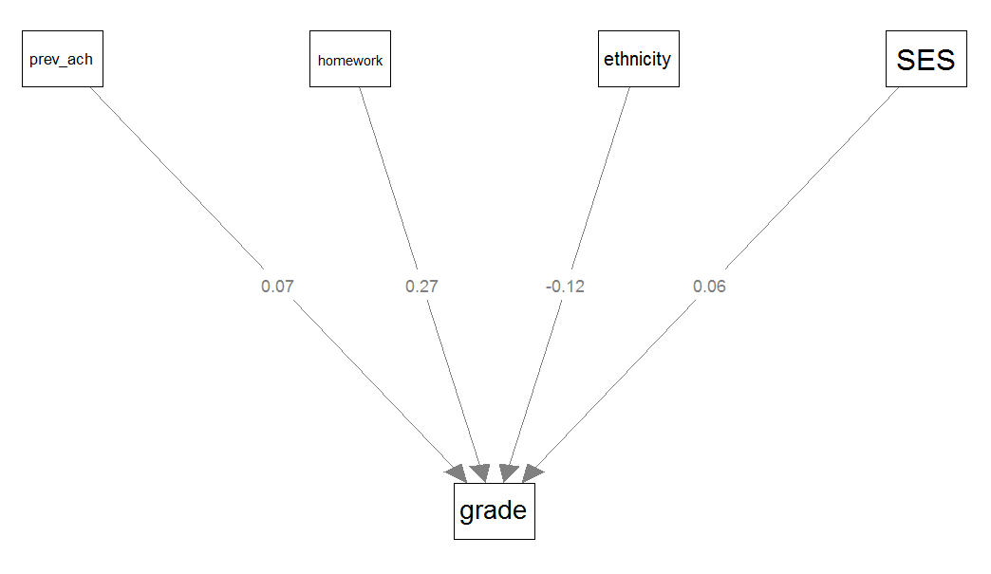

Model: Multiple regression
Dependent:
GPA in 10th grade
Independent:
Ethnicity
Homework (8th grade)
Previous achievement (8th grade)
Socio-economic status
Regression estimates are now a vector of partial regression coefficients, need matrix algebra to compute: $\hat{β}={{(X}^{T}X)}^{−1}X^{T}y$
Measure of fit: multiple correlation (R=.512), or variance explained (R²=.262)
Measure of (strength of) association: ${\hat{b}}_{xy}$ or standardized ${\hat{b}}_{xy}^{∗}=s_{x}\frac{{\hat{b}}_{xy}}{s_{y}}$ (where ${\hat{b}}_{xy}$ is a partial regression coefficient)

Slide 11
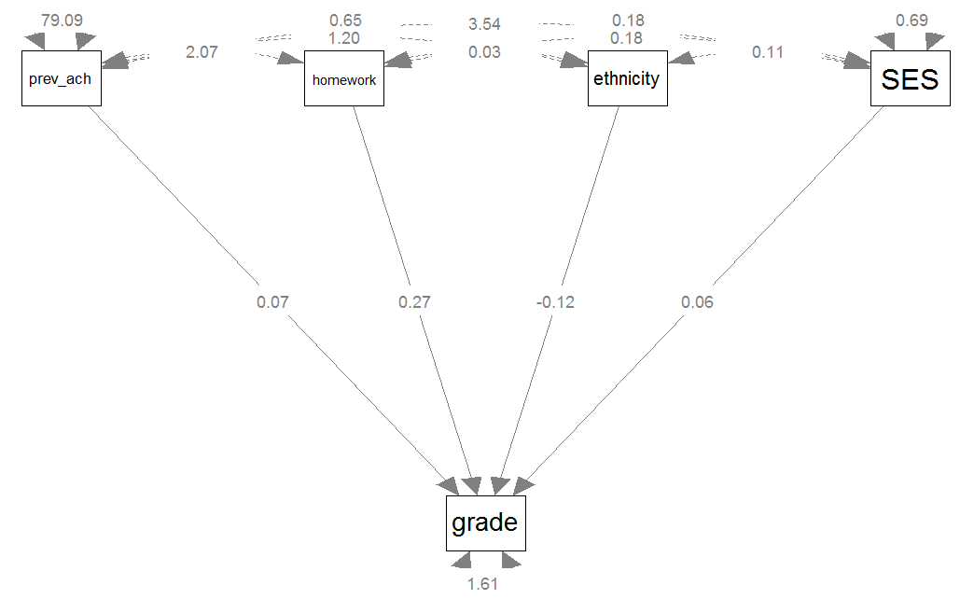

Model: SEM
Endogenous variables:
GPA in 10th grade
Exogenous variables:
Ethnicity
Homework (8th grade)
Previous achievement (8th grade)
Socio-economic status
(disturbance/error/residual) of GPA in 10th grade
Regression estimates are still a vector of partial regression coefficients, need matrix algebra and optimization to compute
Measure of (strength of) associations: Partial regression coefficients
Overall model fit: How well are the observed variables’ (co)variances reproduced by the model?
Quantified by a $χ^{2}$value and model fit indices

Slide 12
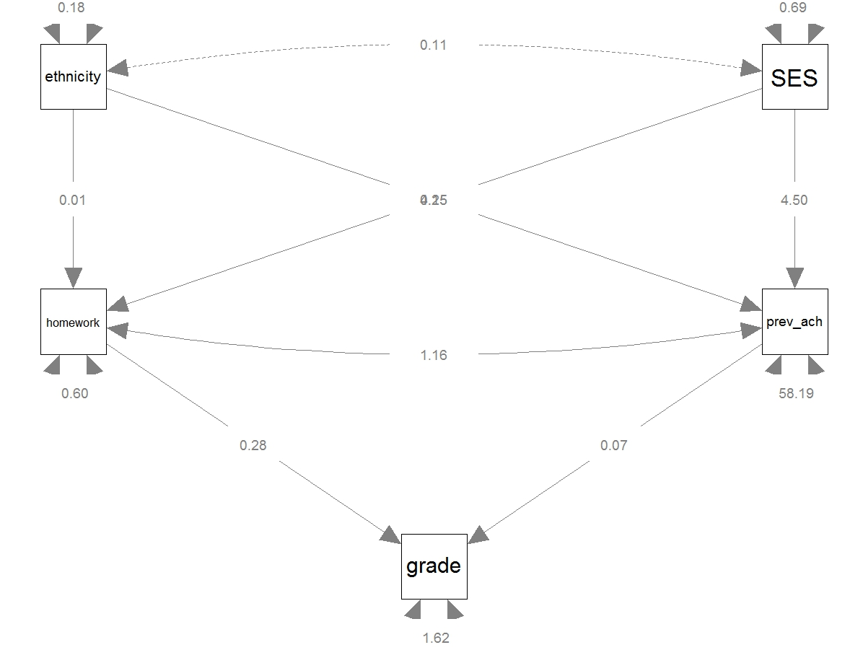

Model: SEM
Endogenous variables:
Homework (8th grade)
Previous achievement (8th grade)
GPA in 10th grade
Exogenous variables:
Ethnicity
Socio-economic status
(disturbances/errors/residuals of
Homework (8th grade)
Previous achievement (8th grade)
GPA in 10th grade
Measure of (strength of) associations: partial regression coefficients
Overall model fit: How well are the observed variables’ (co)variances reproduced by the model?
Quantified by a $χ^{2}$value and model fit indices

Slide 13

Model: SEM
From Greek endo, meaning ‘inside’, and gignomai
Explained by the model.
Have unidirectional incoming arrows.
Endogenous variables:
Homework (8th grade)
Previous achievement (8th grade)
GPA in 10th grade
Exogenous variables:
Ethnicity
Socio-economic status
(disturbances/errors/residuals of
Homework (8th grade)
Previous achievement (8th grade)
GPA in 10th grade
Measure of (strength of) associations: partial regression coefficients
Overall model fit: How well are the observed variables’ (co)variances reproduced by the model?
Quantified by a $χ^{2}$value and model fit indices
Not explained by the model.
Have no unidirectional incoming arrow(s).
From Greek exo, meaning ‘outside’, and gignomai, meaning ‘to produce’

Slide 14
SEM using lavaan
To fit a SEM in R with lavaan, we need two things:
Data, which can be:
Raw data, which is often an external file (e.g., .sav, .xls) which needs to be loaded into R (most common case in practice)
Covariance or correlation matrix, which can be an external file, or can be entered manually (most often the case in book’s examples and exercises)
Model specification:
A long character string that specifies whether population parameters are fixed (e.g., to a constant like 1 or 0) restricted (e.g., to be equal to another parameter) or should be freely estimated, using lavaan model syntax

Slide 15
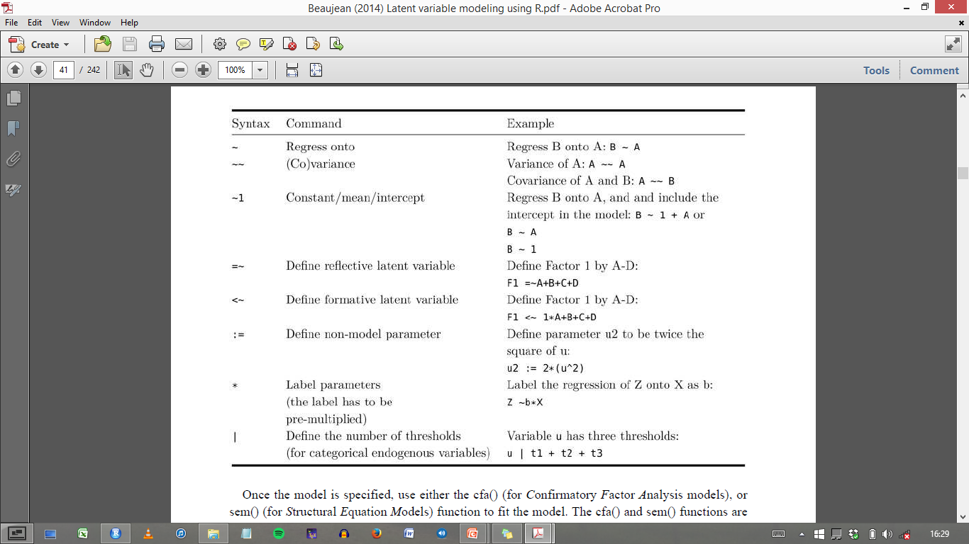
Lavaan model syntax

Slide 16
grade
ethnicity
homework
SES
Prev_ach
Q: How do we specify these models in lavaan syntax?

Slide 17

Computation time!
Example 2.4.1
get PDF from Github
Make Exercise 2.1:
Get Exercises_week_1.pdf from Github (adapted version of the exercises in the Beaujean book)

Slide 18
Structural Equation Modeling
Fitted model is used to explain associations between observed variables
I.e., to explain sample covariances between observed variables:
Note: means, and skewness & kurtosis can be also be involved in SEM (discussed later in course)

Slide 19
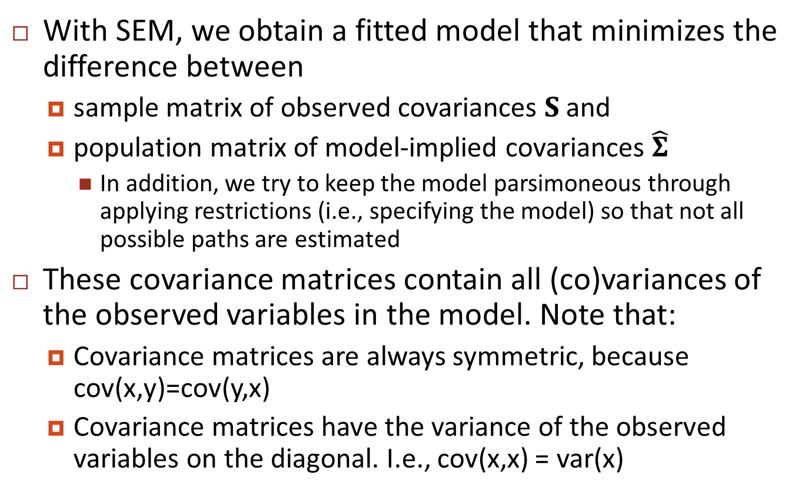
Structural Equation Modeling
With SEM, we obtain a fitted model that minimizes the difference between
sample matrix of observed covariances $S$ and
population matrix of model-implied covariances $\hat{Σ}$
In addition, we try to keep the model parsimoneous through applying restrictions (i.e., specifying the model) so that not all possible paths are estimated
These covariance matrices contain all (co)variances of the observed variables in the model. Note that:
Covariance matrices are always symmetric, because cov(x,y)=cov(y,x)
Covariance matrices have the variance of the observed variables on the diagonal. I.e., cov(x,x) = var(x)

Slide 20
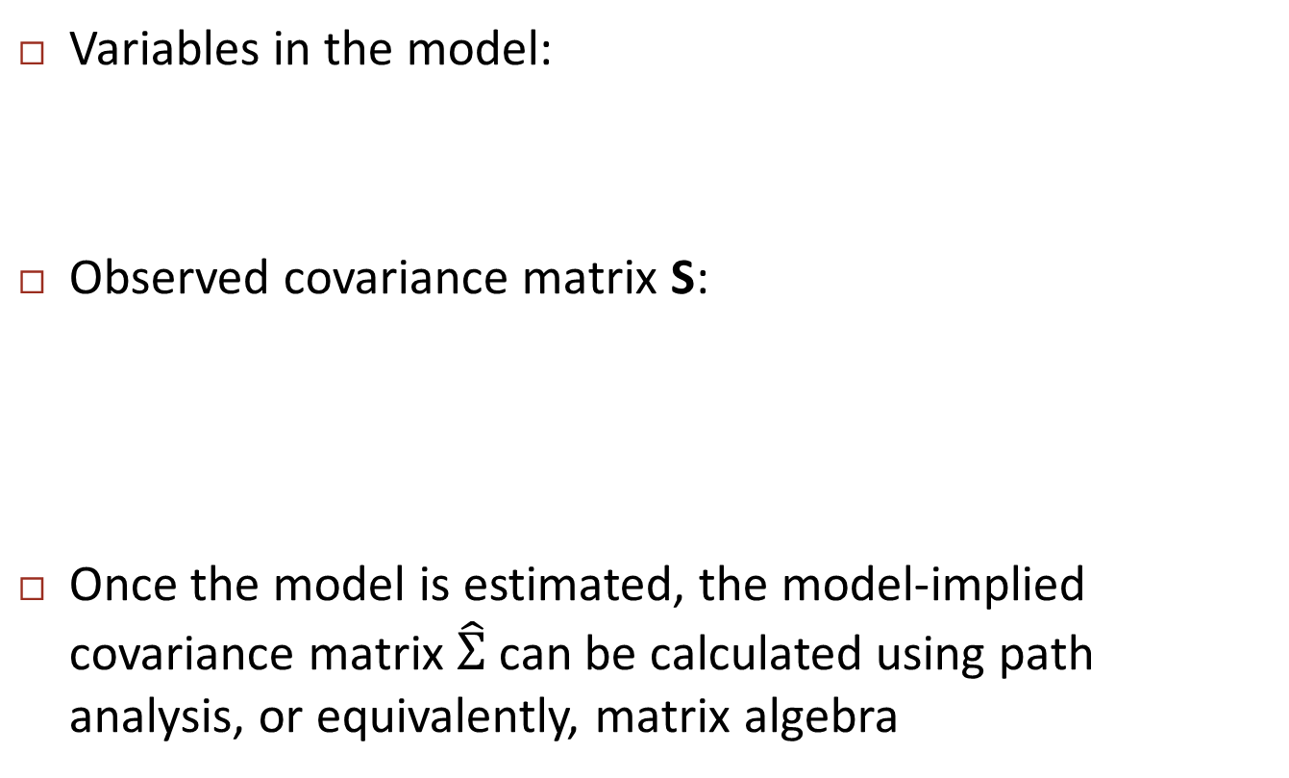
Model-implied (co)variances
Variables in the model:
Observed covariance matrix S:
Once the model is estimated, the model-implied covariance matrix $\hat{Σ}$ can be calculated using path analysis, or equivalently, matrix algebra
grade
ethnicity
homework
SES
Prev_ach

Slide 21
Model-implied (co)variances
Path analysis:
Model-implied covariance between variables X and Y can be computed as follows:
Find all paths leading from X to Y
Multiply all parameter values along a given path from X to Y, but:
No loops: may not go through same variable more than once
May switch forward/backward direction only once within a path
May go through double-headed arrow only once within a path
Summing all values thus obtained
Variances of variables are calculated as follows:
For exogenous variables, model-implied variances are equal to sample variances, so are given (not computed)
For endogenous variables, variances are computed like covariances (rules above)

Slide 22
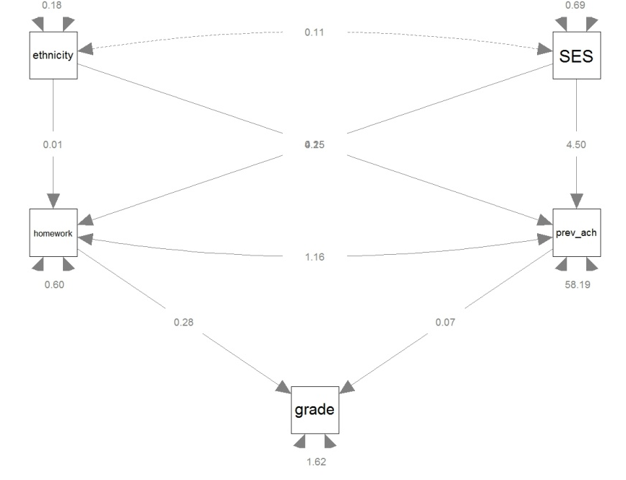
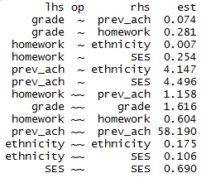
Model-implied (co)variances
Model: Parameter estimates:
Q: What is the model-implied cov(SES, grade)?

Slide 23
Model-implied (co)variances
model-implied cov(SES, grade)=
var(SES) * b(SES, homework) * b(homework, grade) +
var(SES) * b(SES, prev_ach) * b(prev_ach, grade) +
cov(SES, ethnicity) * b(ethnicity, homework) * b(homework, grade) +
cov(SES, ethnicity) * b(ethnicity, prev_ach) * b(prev_ach, grade)

Slide 24
Model-implied (co)variances
Note that Beaujean’s examples in section 2.1.3 seem more simple, because he uses the standardized solution. Then all variances of exogenous variables equal 1 and can be omitted, which simplifies calculations a lot.
model-implied cov(SES,grade)=
var(SES) * b(SES, homework) * b(homework, grade) +
var(SES) * b(SES, prev_ach) * b(prev_ach, grade) +
cov(SES, ethnicity) * b(ethnicity, homework) * b(homework, grade) +
cov(SES, ethnicity) * b(ethnicity, prev_ach) * b(prev_ach, grade) =
.690 * .254 * .281 +
.690 * 4.496 * .074 +
.106 * .007 * .281 +
.106 * 4.147 * .074 =
0.3115514

Slide 25
Model-implied (co)variances
A SEM is a system of linear equations, which we can represent by matrices
Although non-linear SEM also exists, but outside the scope of this course
The path tracing rules represent matrix algebra but more tedious/confusing/error prone
Beaujean’s book hardly involves formulas, and no matrix notation. To get a good understanding of SEM, you need to know about underlying matrices and vectors

Slide 26
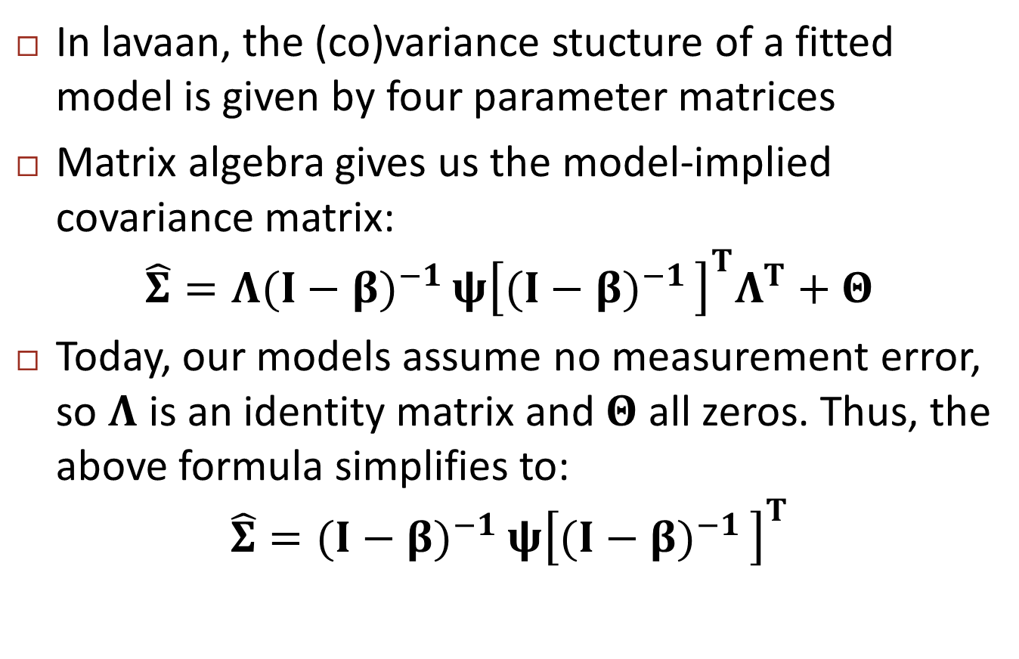
Model-implied (co)variances
In lavaan, the (co)variance stucture of a fitted model is given by four parameter matrices
Matrix algebra gives us the model-implied covariance matrix:
$$\hat{Σ}=Λ{(I−β)}^{−1 }ψ{\left[{(I−β)}^{−1 }\right]}^{T}Λ^{T}+Θ$$
Today, our models assume no measurement error, so $Λ$ is an identity matrix and $Θ$ all zeros. Thus, the above formula simplifies to:
$$\hat{Σ}={(I−β)}^{−1 }ψ{\left[{(I−β)}^{−1 }\right]}^{T}$$

Slide 27
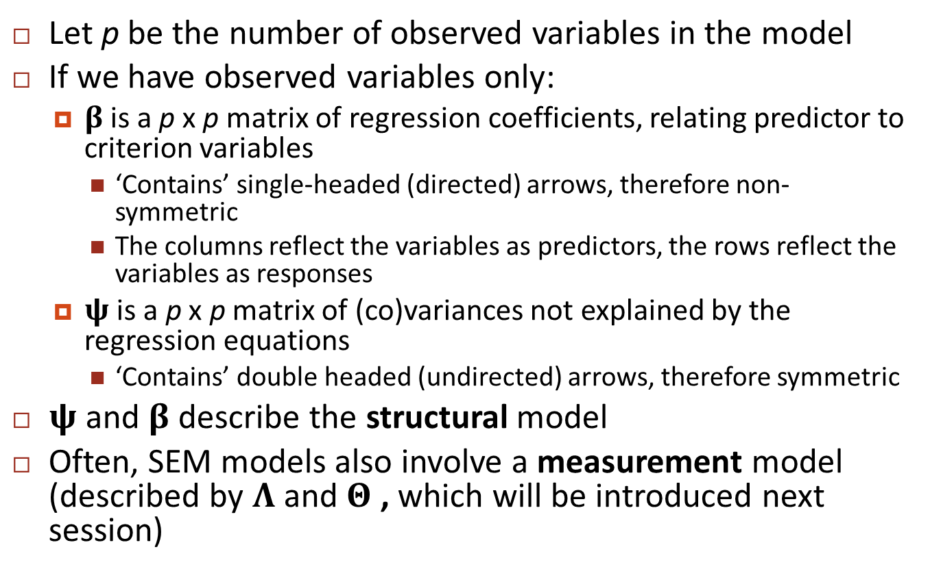
Model-implied (co)variances
Let p be the number of observed variables in the model
If we have observed variables only:
$β$is a p x p matrix of regression coefficients, relating predictor to criterion variables
‘Contains’ single-headed (directed) arrows, therefore non-symmetric
The columns reflect the variables as predictors, the rows reflect the variables as responses
$ψ$ is a p x p matrix of (co)variances not explained by the regression equations
‘Contains’ double headed (undirected) arrows, therefore symmetric
$ψ$ and $β$ describe the structural model
Often, SEM models also involve a measurement model (described by $Λ$ and $Θ$ , which will be introduced next session)

Slide 28
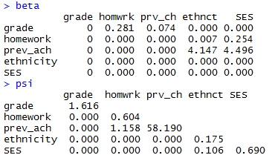
Model-implied (co)variances
Notes:
Psi: symmetric
Beta: non-symmetric. If A ~ B, then A is on row, B is on column

Slide 29
Structural and measurement model
Two main components of SEMs:
the structural model contains causal regression relationships between endogenous and exogenous variables
path models (without measurement errors) can be viewed as SEMs that contain only the structural model
the measurement model contains the associations between latent variables and their indicators
confirmatory factor analysis models contain only the measurement part

Slide 30
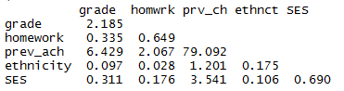

Model-implied (co)variances
Model: Parameter estimates:
Model-implied covariance matrix $\hat{Σ}$ :

Slide 31
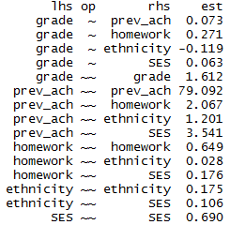
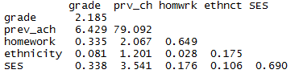

Model-implied (co)variances
Model: Parameter estimates:
Model-implied covariance matrix $\hat{Σ}$:

Slide 32
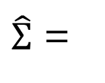
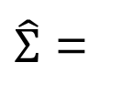
Model-implied (co)variances
$\hat{Σ}$ =
$\hat{Σ}$ =
Which model fits data best (i.e., approximates sample covariances best)?
Which is most parsimonious (i.e., estimates lowest number of population parameters)?
S =

Slide 33
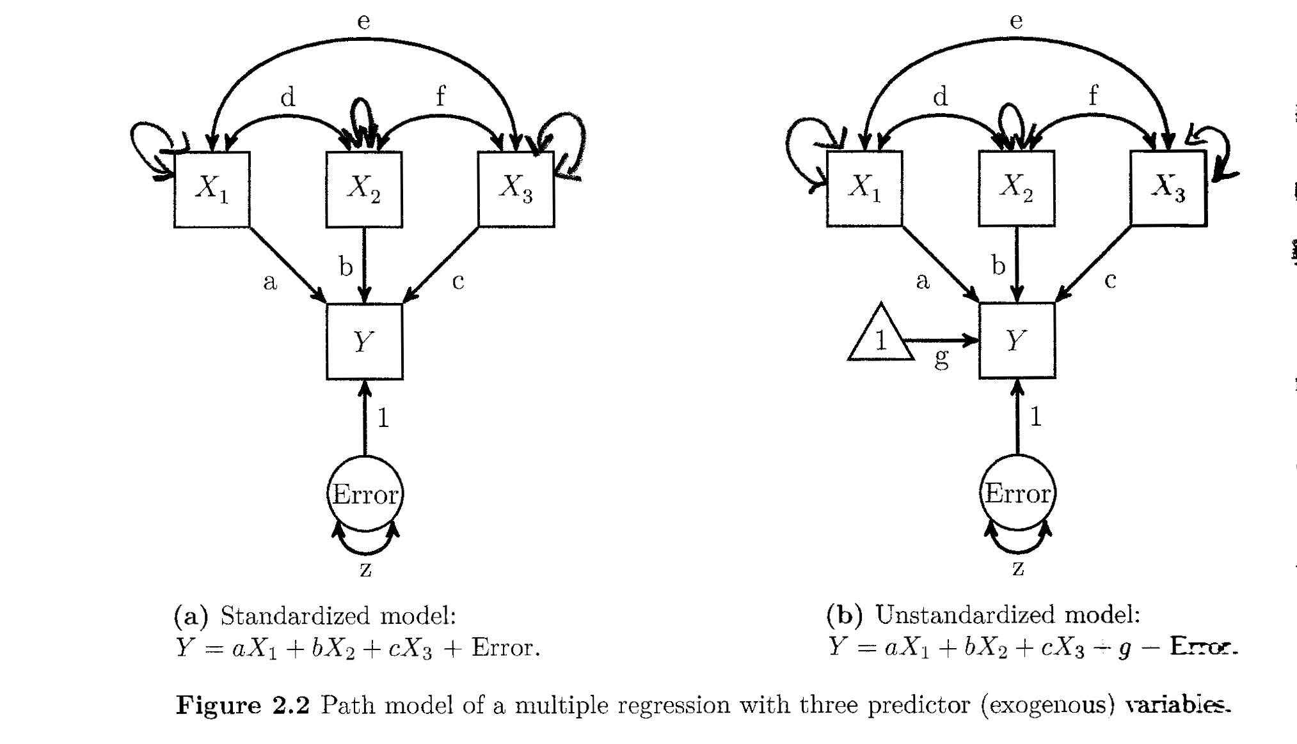
Variances of exogenous variables often not explicitly depicted

Slide 34
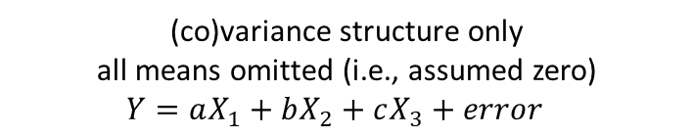
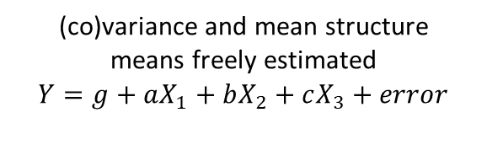
Mean structure often omitted
(co)variance structure only
all means omitted (i.e., assumed zero)
$Y=aX_{1}+bX_{2}+cX_{3}+error$
(co)variance and mean structure
means freely estimated
$Y=g+aX_{1}+bX_{2}+cX_{3}+error$

Slide 35
Error terms
Errors are also latent variables: they are hypothetical, not directly observed
Error is defined as the difference between observed (sample) variance and variance explained by other variables in the model
Therefore, a variable that has an error/disturbance term is an endogenous variable (vice versa)
Errors/disturbance terms are always exogenous (i.e., no incoming directional arrows)

Slide 36

Causation
Causality needs to be ensured through the research design, cannot be statistically proven
Both models above will fit the observed data equally well, it is up to the researcher to decide on the direction of the arrows!
In the SEM model, it is merely a matter of scaling:
$b_{x}=\frac{cov_{xy}}{var_{x}}$ and $b_{y}=\frac{cov_{xy}}{var_{y}}$
error
X
Y
error
Y
X

Slide 37
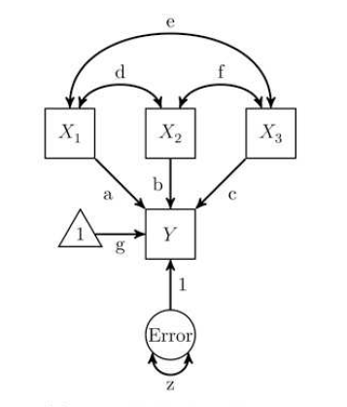
Path & partial regression coefficients
Path coefficients (a, b, c, g and 1) are partial regression coefficients
That is, the expected increase in the response variable, when the predictor variable increases by 1, controlling for (= keeping constant) all the other predictor variables
Note that the intercept is always 1, so cannot in- or decrease

Slide 38
Standardized coefficients
Parameter estimates (path coefficients) can be standardized and unstandardized
Unstandardized: Interpret like regression coefficients
Expected increase in Y if X increases by 1
Standardized: Interpret like correlation coefficients
Expected increase in SDs of Y if X increases by 1 SD
0: no linear association; -1: perfect negative association; 1: perfect positive association
squared standardized coefficient = prop. of variance in Y explained by X (vice versa)

Slide 39
Lavaan model syntax

Slide 40
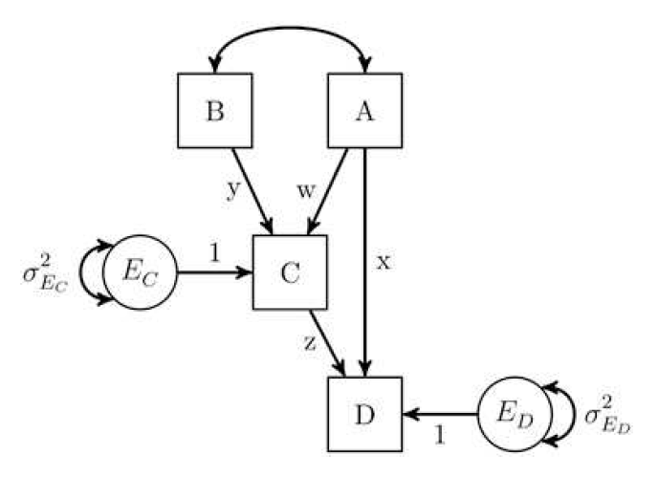
Lavaan syntax exercise
How do we write the model below in lavaan syntax?
How can we label and refer to the indirect effect from A on D via C in lavaan syntax?
What do the beta and psi matrices for this model look like?
Note that Beaujean often labels paths in lavaan syntax, but that is not required - I never do it, unless there are indirect effects that I want to explicitly define in the model. Labeling or not does not make a difference for the estimated parameters and model fit.
Notes:
Beta: If A ~ B, A is on row and B is on column

Slide 41
Homework
Exercises 2.2 and 2.3 (see PDF on GitHub repo)
See Example-2.4.1.pdf on GitHub repo for instructions on extracting beta and psi matrices

